Slide 1

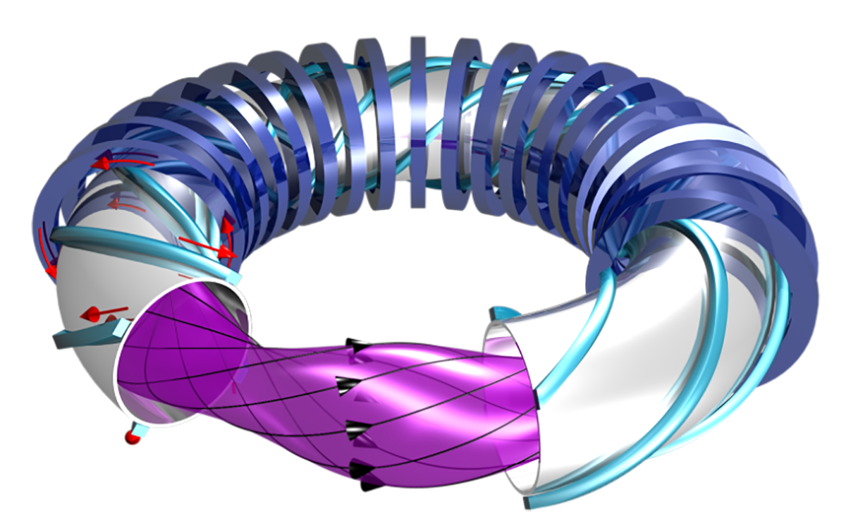
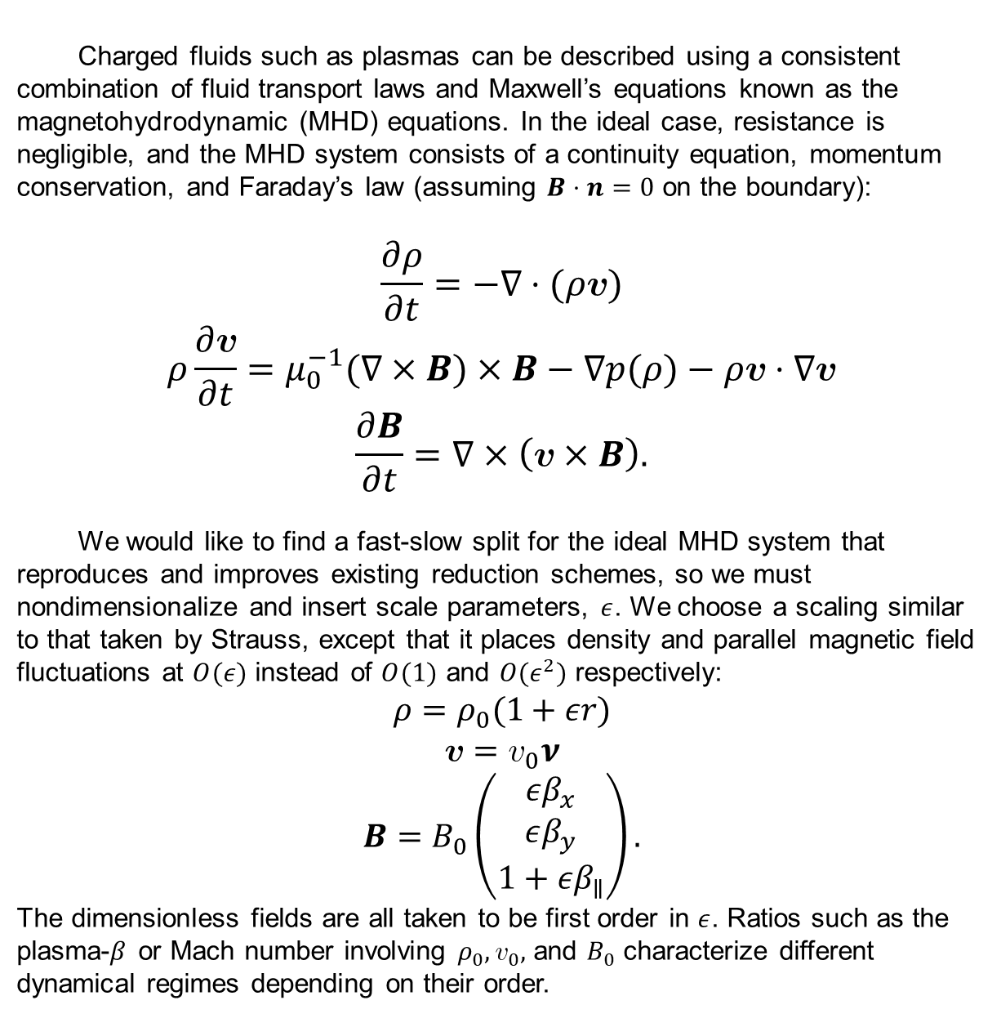
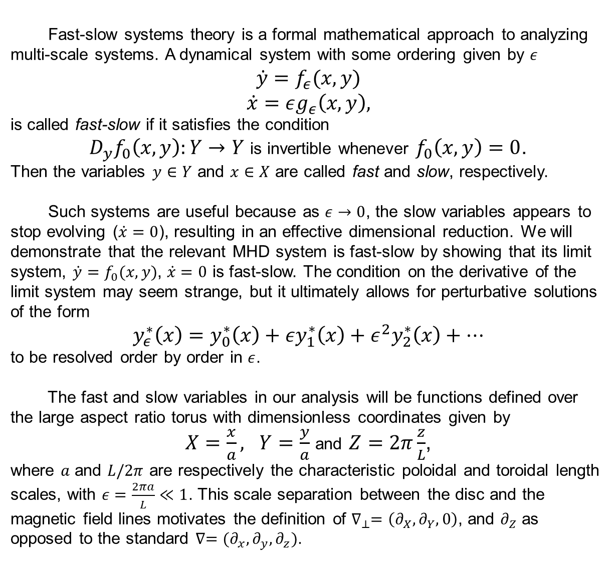
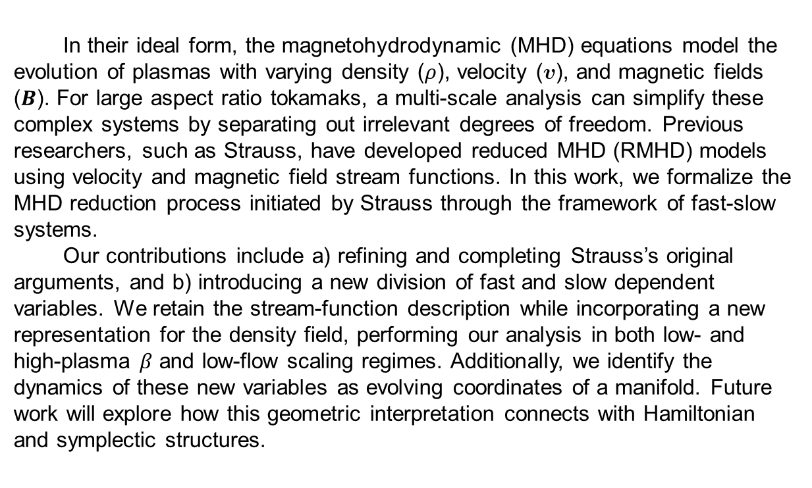
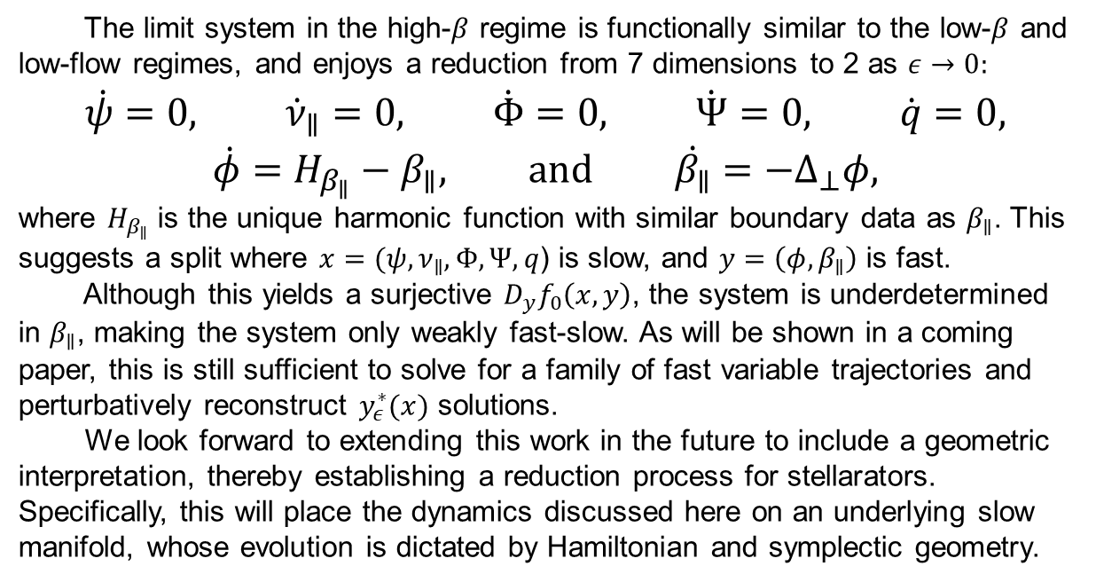
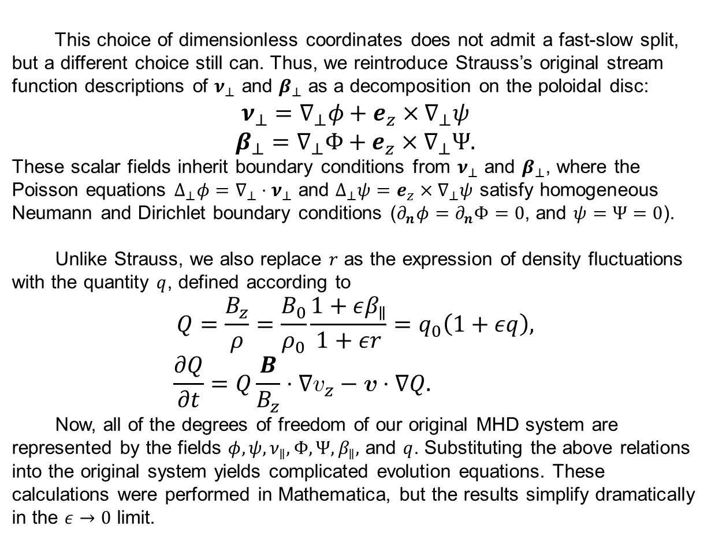
Formally Reducing the Large Aspect Ratio Magnetohydrodynamic Equations
Finny Valorz¹, Supervisor: Joshua Burby¹ ¹Department of Physics, College of Natural Sciences, The University of Texas
Introduction
MHD System and Scaling
Conclusion
In their ideal form, the magnetohydrodynamic (MHD) equations model the evolution of plasmas with varying density ($ρ$), velocity ($v$), and magnetic fields ($B$). For large aspect ratio tokamaks, a multi-scale analysis can simplify these complex systems by separating out irrelevant degrees of freedom. Previous researchers, such as Strauss, have developed reduced MHD (RMHD) models using velocity and magnetic field stream functions. In this work, we formalize the MHD reduction process initiated by Strauss through the framework of fast-slow systems.
Our contributions include a) refining and completing Strauss’s original arguments, and b) introducing a new division of fast and slow dependent variables. We retain the stream-function description while incorporating a new representation for the density field, performing our analysis in both low- and high-plasma $β$ and low-flow scaling regimes. Additionally, we identify the dynamics of these new variables as evolving coordinates of a manifold. Future work will explore how this geometric interpretation connects with Hamiltonian and symplectic structures.
Charged fluids such as plasmas can be described using a consistent combination of fluid transport laws and Maxwell’s equations known as the magnetohydrodynamic (MHD) equations. In the ideal case, resistance is negligible, and the MHD system consists of a continuity equation, momentum conservation, and Faraday’s law (assuming $B⋅n=0$ on the boundary):
$$\frac{∂ρ}{∂t}=−∇⋅(ρv)$$
$$ρ\frac{∂v}{∂t}=μ_{0}^{−1}(∇×B)×B−∇p(ρ)−ρv⋅∇v$$
$$\frac{∂B}{∂t}=∇×\left(v×B\right).$$
We would like to find a fast-slow split for the ideal MHD system that reproduces and improves existing reduction schemes, so we must nondimensionalize and insert scale parameters, $ε$. We choose a scaling similar to that taken by Strauss, except that it places density and parallel magnetic field fluctuations at $O(ε)$ instead of $O(1)$ and $O(ε^{2})$ respectively:
$$ρ=ρ_{0}(1+εr)$$
$$v=v_{0}ν$$
$$B=B_{0}\left(\begin{matrix}εβ_{x} \\ εβ_{y} \\ 1+εβ_{∥}\end{matrix}\right).$$
The dimensionless fields are all taken to be first order in $ε$. Ratios such as the plasma-$β$ or Mach number involving $ρ_{0},v_{0},$ and $B_{0}$ characterize different dynamical regimes depending on their order.
Research Goal
https://www.iaea.org/bulletin/magnetic-fusion-confinement-with-tokamaks-and-stellarators
In this project, we carry out a dimensional reduction of the MHD equations by observing a fast-slow split. Reducing the typical tokamak equations this way is a necessary precursor for reducing MHD in general stellarator geometries.
The limit system in the high-$β$ regime is functionally similar to the low-$β$ and low-flow regimes, and enjoys a reduction from 7 dimensions to 2 as $ε→0$:
$$\dot{ψ}=0, {\dot{ν}}_{∥}=0, \dot{Φ}=0, \dot{Ψ}=0, \dot{q}=0,$$
$$\dot{φ}=H_{β_{∥}}−β_{∥}\text{,} \text{and} \dot{β_{∥}}=−Δ_{⊥}φ,$$
where $H_{β_{∥}}$ is the unique harmonic function with similar boundary data as $β_{∥}$. This suggests a split where $x=(ψ,ν_{∥},Φ,Ψ,q$) is slow, and $y=\left(φ,β_{∥}\right)$ is fast.
Although this yields a surjective $D_{y}f_{0}\left(x,y\right)$, the system is underdetermined in $β_{∥}$, making the system only weakly fast-slow. As will be shown in a coming paper, this is still sufficient to solve for a family of fast variable trajectories and perturbatively reconstruct $y_{ε}^{∗}(x)$ solutions.
We look forward to extending this work in the future to include a geometric interpretation, thereby establishing a reduction process for stellarators. Specifically, this will place the dynamics discussed here on an underlying slow manifold, whose evolution is dictated by Hamiltonian and symplectic geometry.
Slow Manifold Reduction
Fast-slow systems theory is a formal mathematical approach to analyzing multi-scale systems. A dynamical system with some ordering given by $ε$
$$\dot{y}=f_{ε}(x,y)$$
$$\dot{x}=εg_{ε}\left(x,y\right),$$
is called fast-slow if it satisfies the condition
$D_{y}f_{0}\left(x,y\right):Y→Y$ is invertible whenever $f_{0}\left(x,y\right)=0$.
Then the variables $y∈Y$ and $x∈X$ are called fast and slow, respectively.
Such systems are useful because as $ε→0$, the slow variables appears to stop evolving ($\dot{x}=0$), resulting in an effective dimensional reduction. We will demonstrate that the relevant MHD system is fast-slow by showing that its limit system, ${\dot{y}=f}_{0}(x,y)$, $\dot{x}=0$ is fast-slow. The condition on the derivative of the limit system may seem strange, but it ultimately allows for perturbative solutions of the form
$$y_{ε}^{∗}\left(x\right)=y_{0}^{∗}\left(x\right)+εy_{1}^{∗}\left(x\right)+ε^{2}y_{2}^{∗}\left(x\right)+⋯$$
to be resolved order by order in $ε$.
The fast and slow variables in our analysis will be functions defined over the large aspect ratio torus with dimensionless coordinates given by
$X=\frac{x}{a}, Y=\frac{y}{a}$ and $Z=2π\frac{z}{L}$,
where $a$ and $L/2π$ are respectively the characteristic poloidal and toroidal length scales, with $ε=\frac{2πa}{L}≪1$. This scale separation between the disc and the magnetic field lines motivates the definition of $∇_{⊥}=\left(∂_{X},∂_{Y},0\right)$, and $∂_{Z}$ as opposed to the standard $∇=(∂_{x},∂_{y},∂_{z})$.
Finding Fast-Slow Coordinates
This choice of dimensionless coordinates does not admit a fast-slow split, but a different choice still can. Thus, we reintroduce Strauss’s original stream function descriptions of $ν_{⊥}$ and $β_{⊥}$ as a decomposition on the poloidal disc:
$$ν_{⊥}=∇_{⊥}φ+e_{z}×∇_{⊥}ψ$$
$$β_{⊥}=∇_{⊥}Φ+e_{z}×∇_{⊥}Ψ.$$
These scalar fields inherit boundary conditions from $ν_{⊥}$ and $β_{⊥}$, where the Poisson equations $Δ_{⊥}φ=∇_{⊥}⋅ν_{⊥}$ and $Δ_{⊥}ψ=e_{z}×∇_{⊥}ψ$ satisfy homogeneous Neumann and Dirichlet boundary conditions ($∂_{n}φ=∂_{n}Φ=0$, and $ψ=Ψ=0$).
Unlike Strauss, we also replace $r$ as the expression of density fluctuations with the quantity $q$, defined according to
$$Q=\frac{B_{z}}{ρ}=\frac{B_{0}}{ρ_{0}}\frac{1+εβ_{∥}}{1+εr}=q_{0}\left(1+εq\right),$$
$$\frac{∂Q}{∂t}=Q\frac{B}{B_{z}}⋅∇v_{z}−v⋅∇Q.$$
Now, all of the degrees of freedom of our original MHD system are represented by the fields $φ, ψ, ν_{∥}, Φ, Ψ, β_{∥},$ and $q$. Substituting the above relations into the original system yields complicated evolution equations. These calculations were performed in Mathematica, but the results simplify dramatically in the $ε→0$ limit.
Acknowledgements
I would like to thank Joshua Burby for his guidance and support throughout this project. Thank you also to Ivan Maldonado, Michael Updike, Erik Hansen, and especially Finn Pinto for our insightful conversations.
References
H. R. Strauss. ‘Dynamics of high β tokamaks’, Phys. Fluids 20, 1354 (1977).
H. R. Strauss. ‘Nonlinear, three-dimensional magnetohydrodynamics of
noncircular tokamaks’, Phys. Fluids 19, 134 (1976).
J. W. Burby and T. J. Klotz. ‘Slow manifold reduction for plasma science,’
CNSNS 89, (2020).

